Slide 1
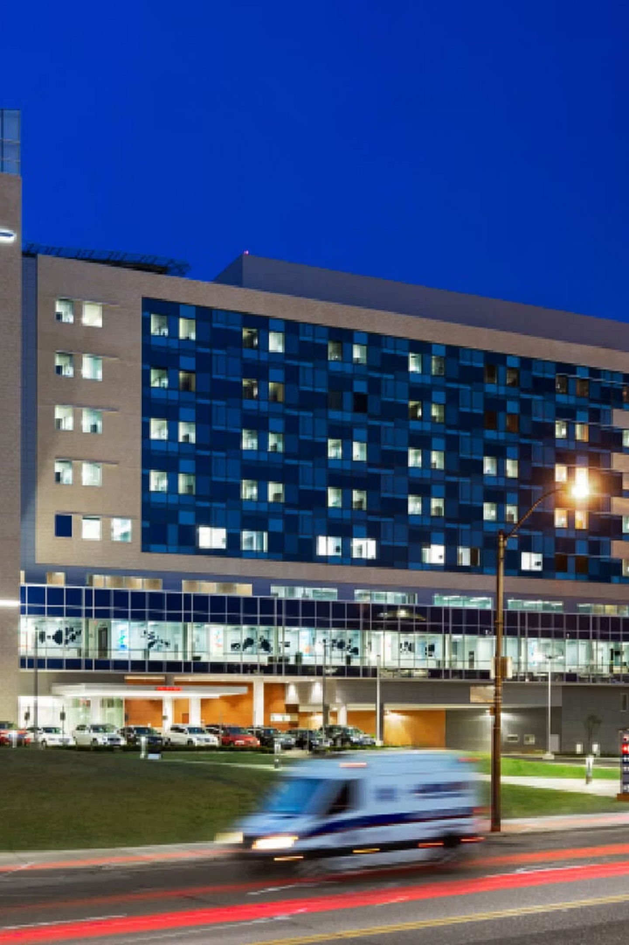
ActiGraft PRO: A Partnership Opportunity for Methodist Le Bonheur Wound Care
Presented to Sandy [Last Name] and the Methodist Le Bonheur Wound Care Team | [Date]

Slide 2
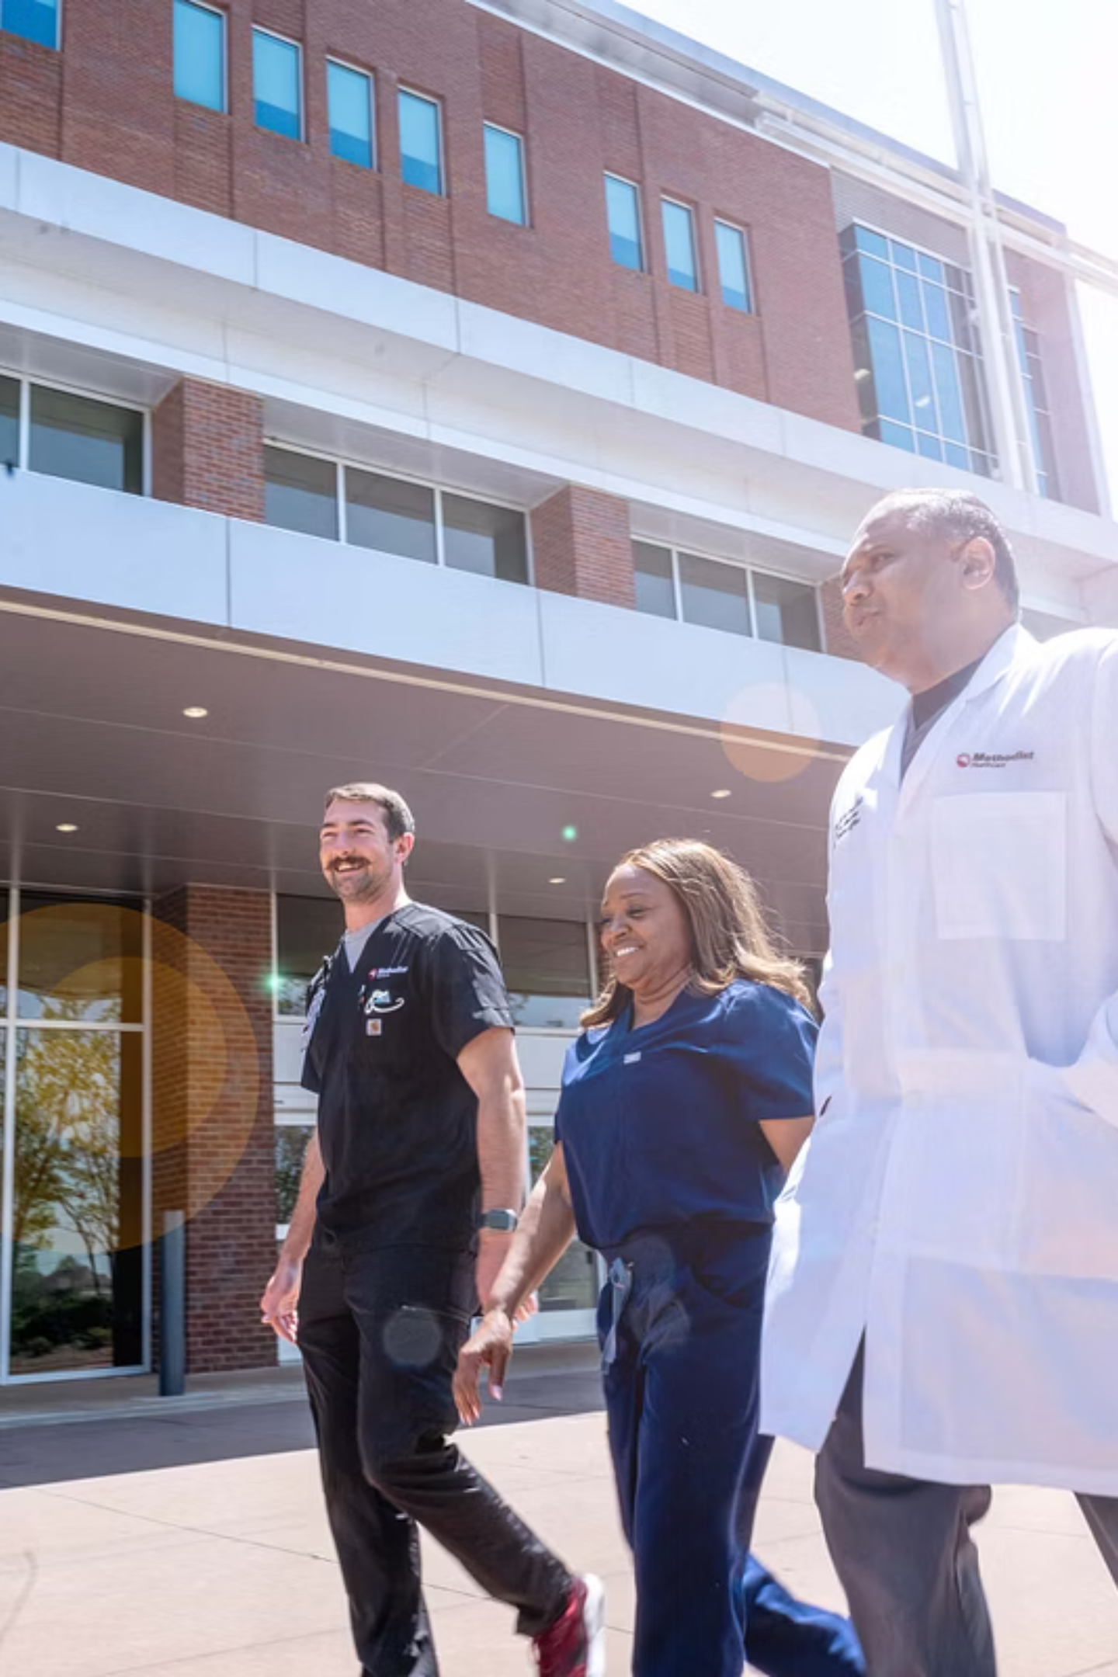


Thank You for Your Leadership
Thank you, Sandy and the dedicated team at Methodist Le Bonheur Wound Care, for your exceptional work.
Unwavering commitment to patient outcomes
Expertise and empathy in treating complex diabetic wounds
Inspiring willingness to explore innovative solutions
We're here as partners and consultants—not sales reps—to support your mission.

Slide 3
Today's Discussion
01
02
03
The Challenge
The Solution
The Opportunity
Wound care crisis in the Mid-South
ActiGraft PRO technology and clinical evidence
Why Methodist Le Bonheur is perfectly positioned
04
05
The Partnership
Next Steps
How Nightingale supports your success
Working together

Slide 4
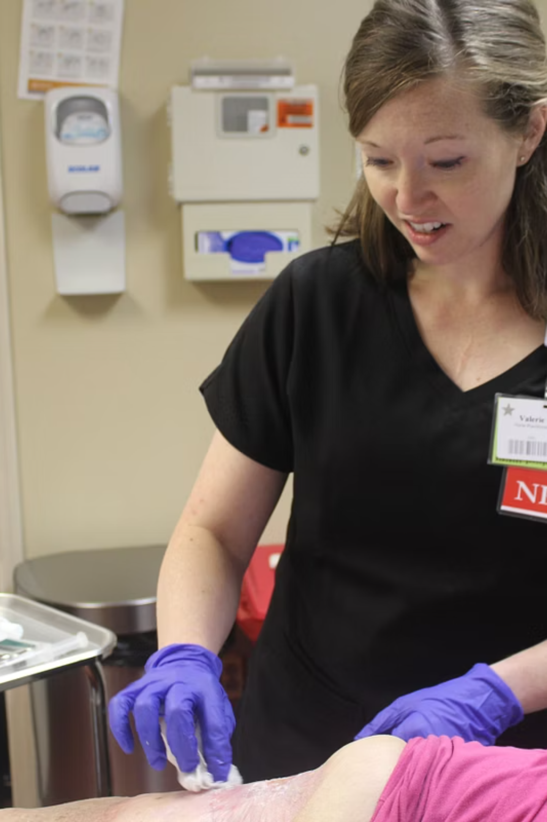

The Challenge We Face Together
These are the patients walking through your doors every day:
100%
15-18%
90%
Mississippi Counties
Delta Region Prevalence
Amputees
Never received an angiogram before amputation
In the CDC-designated Diabetes Belt
vs. 10% national average
34.1%
Tippah County Diabetes Rate
Potentially highest in the U.S.
What if we could change the trajectory for these patients?

Slide 5
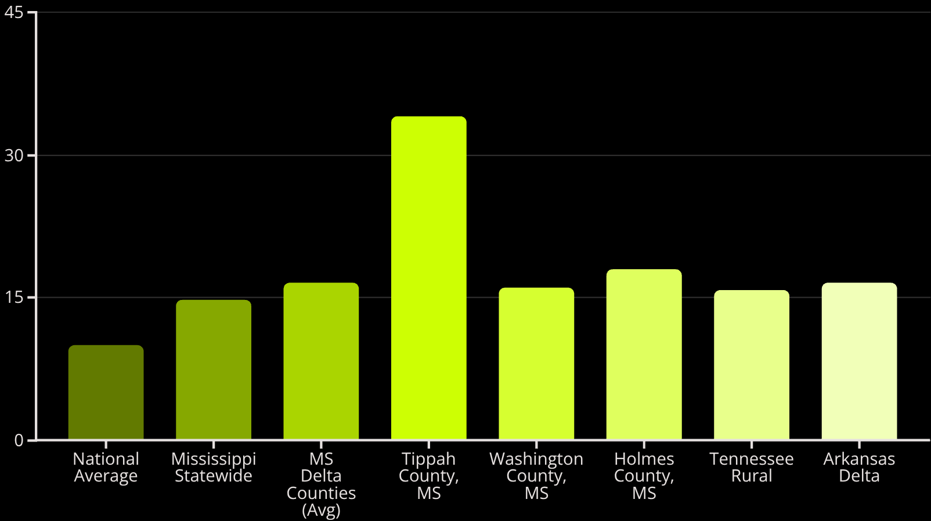
The Diabetes Belt: Geographic Epidemiology Drives Market Opportunity
The CDC Diabetes Belt data tells a stark story:
Diabetes Prevalence Rates Across Key Regions
Clinical & Commercial Implications
50-80% more Diabetic Foot Ulcers (DFUs) than national average
Consistent high patient volume
Stable Medicare reimbursement
Urgent need for effective solutions
48%
241%
Higher prevalence in Mississippi vs. national baseline
Higher prevalence in Tippah County vs. national
Every County
in Mississippi falls within the CDC Diabetes Belt

Slide 6
Memphis Corridor: By The Numbers
Make this a visual dashboard of key numbers that tell the Memphis opportunity story at a glance.
40+
15-18%
3
Multiple
Account Opportunities
Delta Diabetes Prevalence
States
GPOs
Tennessee, Mississippi, Arkansas (Comprehensive coverage)
Vizient, Premier, Healogics iSupply (Immediate access pathways)
Identified facilities in 3-hour radius
vs 10% national average
$1,800
2.73x
Per Treatment Reimbursement
Greater Odds of Closure
Hospital outpatient setting
vs standard of care

Slide 7

The Mississippi Delta Amputation Crisis: A Call to Action
The Mississippi Delta faces the nation's most severe amputation crisis.
90%
50-70%
$150K-$250K
Amputees never received angiogram
5-year mortality post-amputation
Lifetime amputation costs
Two Paths: Amputation vs. Limb Salvage
Amputation Pathway
Limb Salvage Pathway (with ActiGraft + HBOT)
5-year mortality: 50-70%
Lifetime cost: $200,000+
Loss of independence
Preserved mobility
Reduced mortality
Lower total cost
Maintained quality of life
{ "step": [ { "text": "<h4>Untreated Ulcer</h4><p>Chronic wound without vascular care</p>" }, { "text": "<h4>Infection & Ischemia</h4><p>Worsening tissue damage and risk</p>" }, { "text": "<h4>Amputation</h4><p>Limb loss with high mortality</p>" }, { "h4>ActiGraft Intervention</h4><p>Targeted grafting to restore tissue</p>" }, { "text": "<h4>Limb Salvage & Survival</h4><p>Reduced amputation and extended life</p>" } ], "colorScheme": "monochrome" }
ActiGraft isn't just a product—it's a limb salvage mission.
Methodist Le Bonheur's Role in Limb Salvage
Your hyperbaric oxygen program and limb preservation protocols position you perfectly to lead the fight against preventable amputations. ActiGraft enhances these existing capabilities—it's designed to work alongside HBOT and vascular interventions you're already performing.

Slide 8
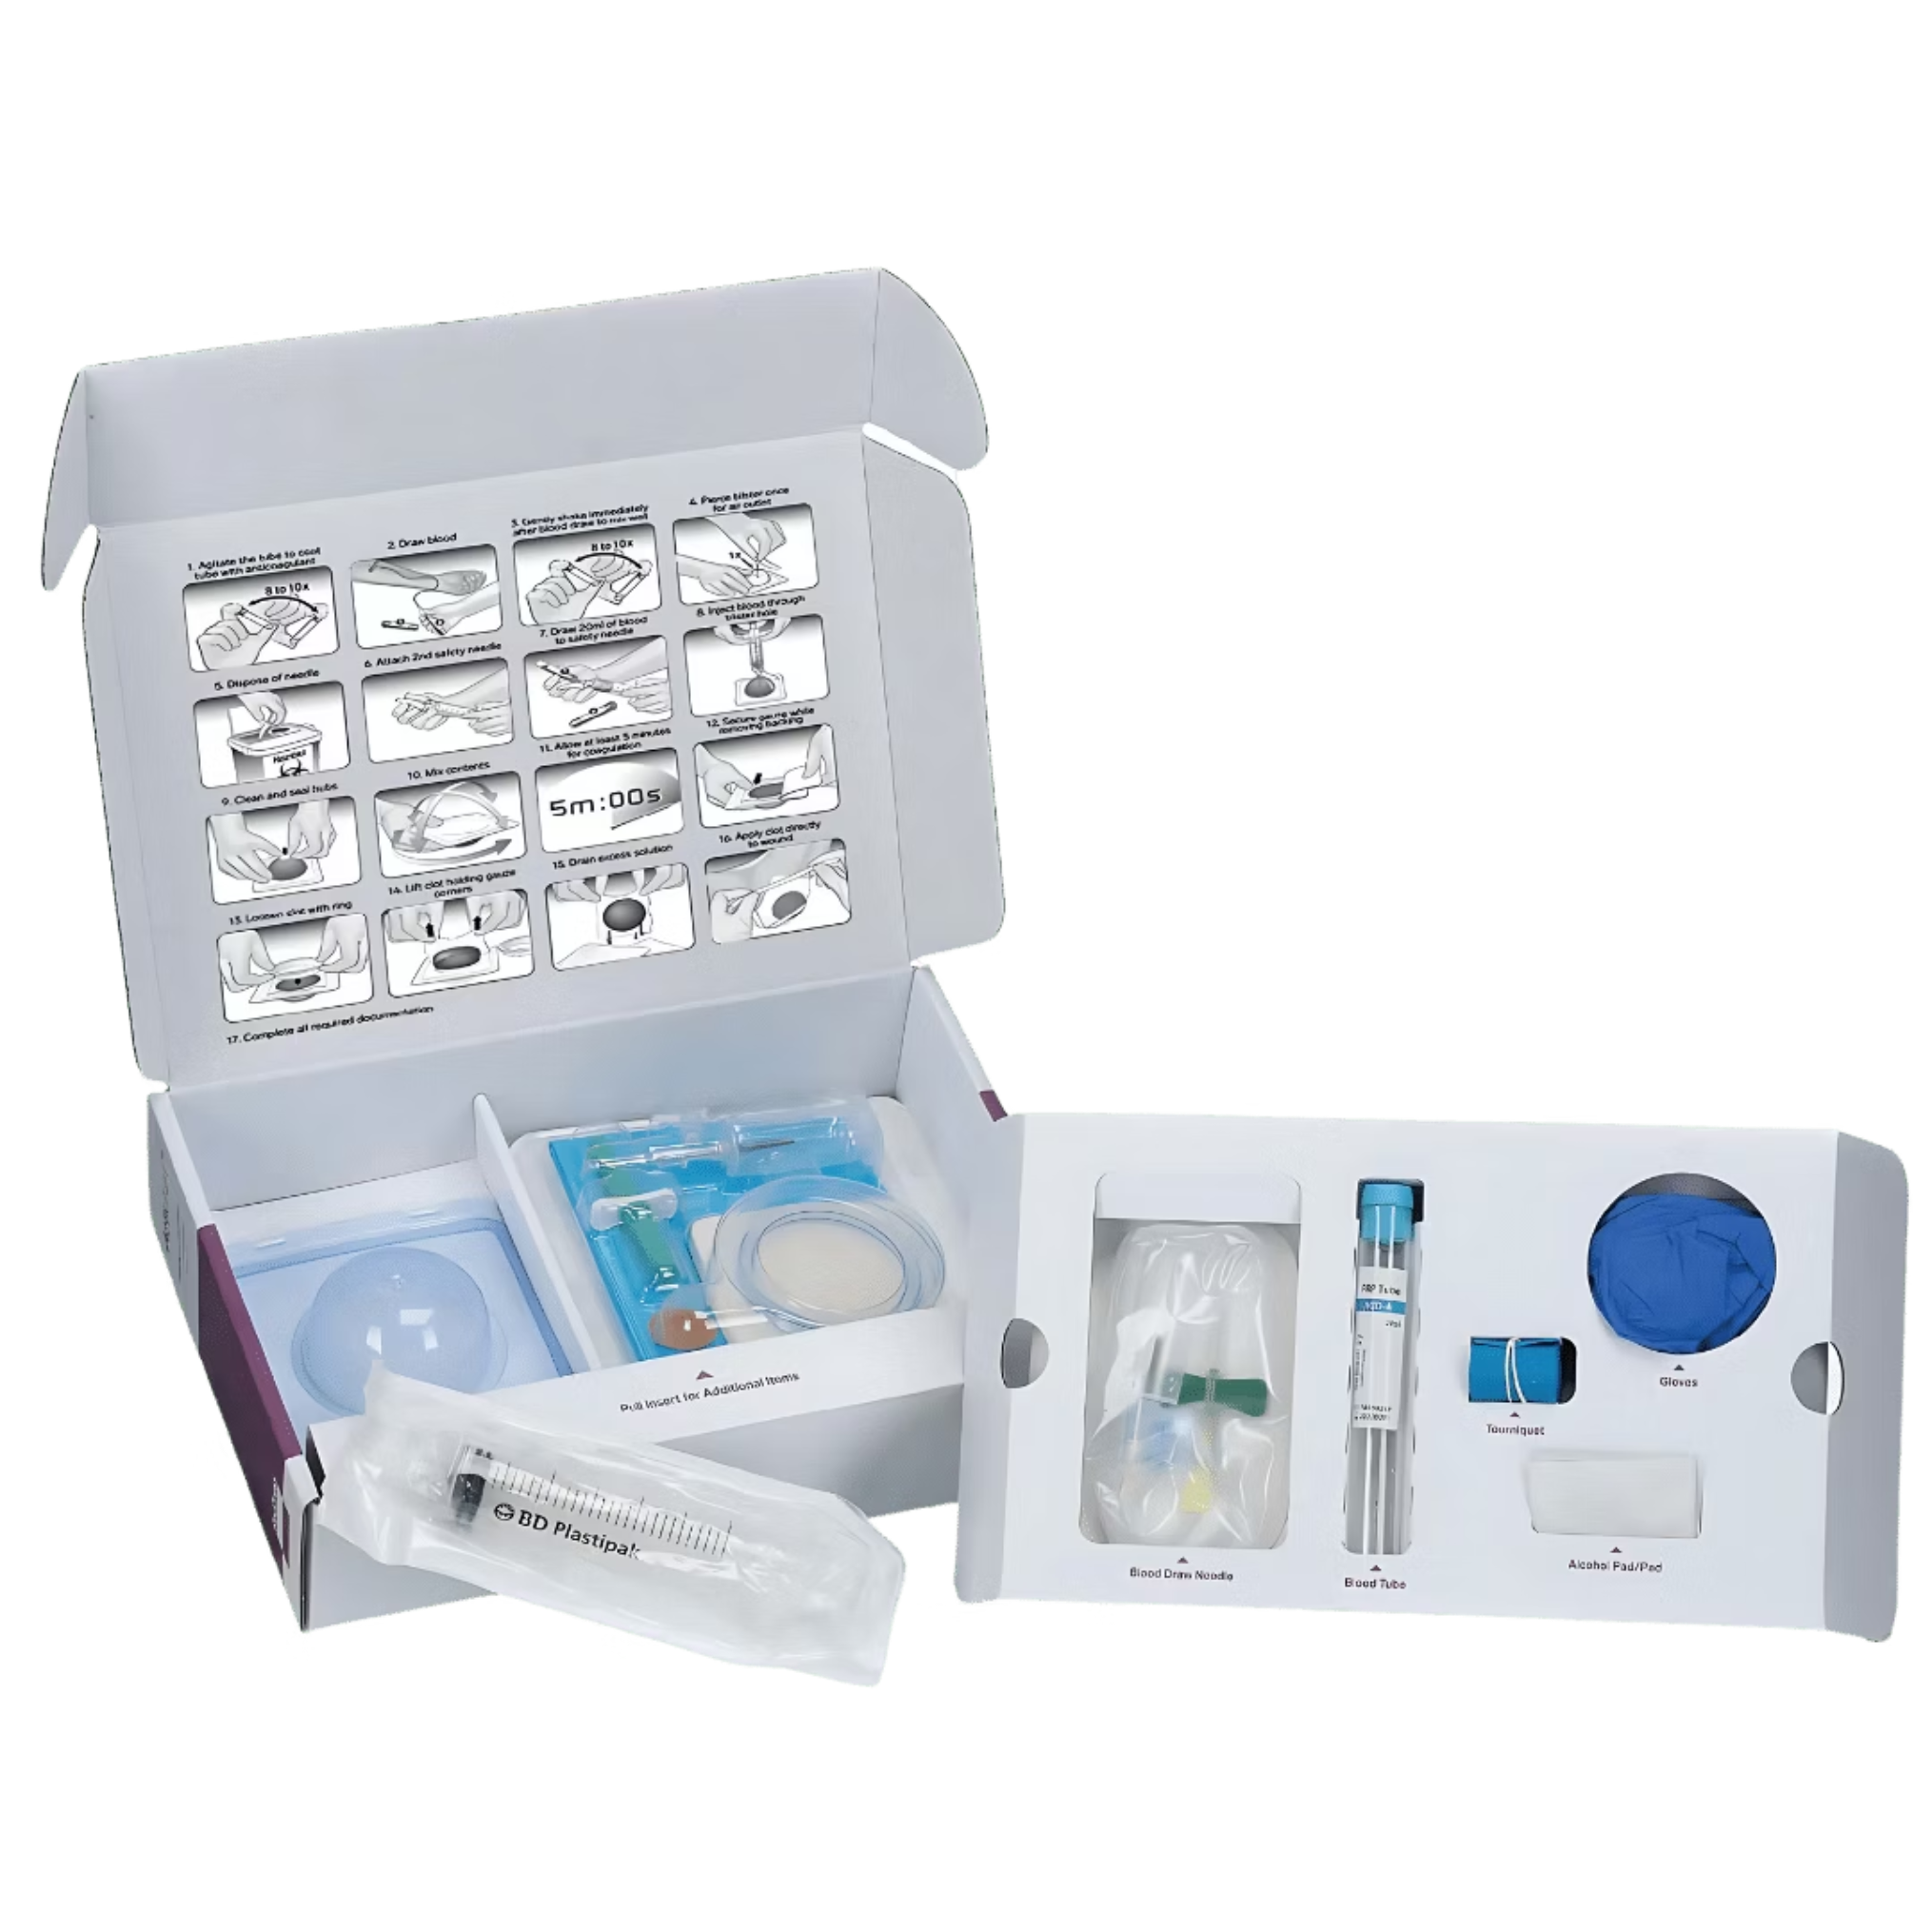
ActiGraft PRO: Mechanism of Action and Clinical Differentiation
What Makes ActiGraft Different
Key Advantages
Autologous (patient's own blood)
No cold chain (room temp storage)
No capital equipment needed
No animal products
Weekly application
Point-of-care preparation
Whole blood clot (not just PRP)
Contains: RBCs, WBCs, platelets, growth factors, stem cells
20-minute preparation, no centrifuge
28 cm² clot treats wounds up to 56 cm²
The image alongside displays the actual ActiGraft PRO product kit, illustrating the components used in its application.

Slide 9

How ActiGraft Works: Simple 3-Step Process
This visual demonstration highlights the easy preparation process:
01
02
03
Step 1: Blood Draw
Step 2: Preparation
Step 3: Application
18 mL blood draw from patient (standard venipuncture)
Mix blood with coagulation powder in sterile mold
No centrifuge needed | 5-minute clot formation | 20 minutes total
Apply 28 cm² clot directly to wound
Weekly application | Remains active ~7 days
Point-of-care preparation. No lab handoff. No specialized equipment.

Slide 10
Pivotal Clinical Evidence: The Multicenter Randomized Controlled Trial
1
Greater Odds of Closure
Statistically significant improvement in complete wound healing versus standard of care alone
2
Complete Healing Rate
ActiGraft PRO group achieved 51% complete closure at 12 weeks (ITT analysis)
3
Control Group Healing
Level 1 evidence from a multicenter RCT published September 2024.
Standard of care alone resulted in only 18% complete closure—highlighting unmet clinical need
119 patients, 16 clinical sites
Lead PI: Dr. Robert J. Snyder, Barry University
ITT analysis: 51% healing vs 18% control
2.73× greater odds of complete closure
Real-world registry: 72% closure rate (7,000+ patients)
What would these outcomes mean for your patient population?

Slide 11


Real-World Application: ActiGraft in Limb Salvage Protocols
This should show how ActiGraft fits into a comprehensive limb preservation treatment plan.
Assessment
Advanced Therapy
Angiogram, revascularization, infection control
HBOT, weekly ActiGraft PRO, NPWT
Ongoing Care
Wound Prep
Weekly reviews, HBOT, reapply ActiGraft, education
Debridement, offloading, moisture balance
Key Point: ActiGraft integrates seamlessly into your existing protocols. It doesn't replace HBOT or other modalities—it works WITH them.
Centers using ActiGraft + HBOT report enhanced healing rates in complex limb salvage cases.
How many of your current HBOT patients could benefit from simultaneous ActiGraft therapy?

Slide 12
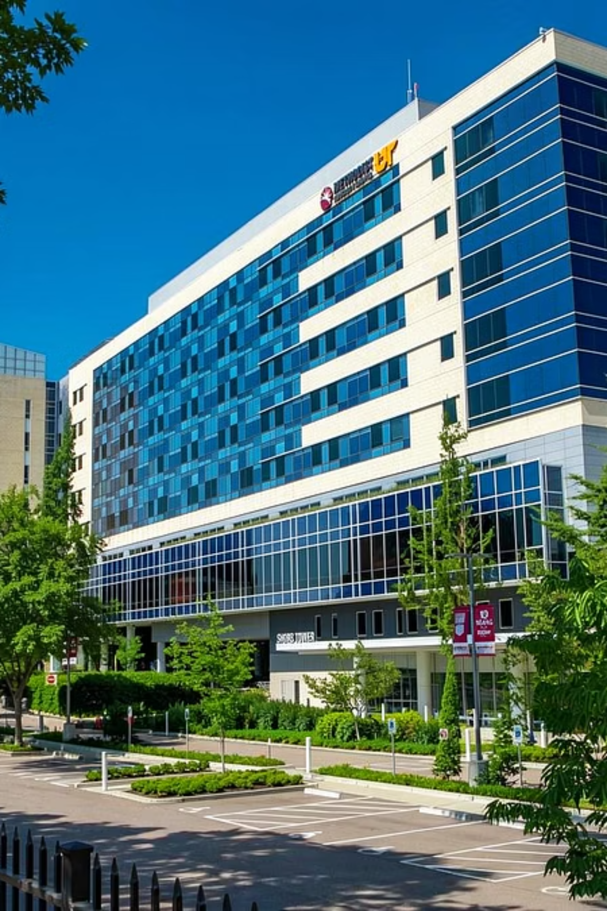
Why Methodist Le Bonheur? Why Now?
You're Perfectly Positioned
Premier GPO Alignment & Key Benefits
Premier GPO member (contract active since March 2022)
Multi-facility system benefits from room-temp storage
UTHSC academic affiliation = evidence-based innovation
Regional leadership position
High diabetes patient population
Established hyperbaric oxygen & limb preservation programs
✓ Verified Premier member
✓ Contract effective March 2022
✓ No local RFP or negotiation needed
✓ VAC approval via existing GPO pathway
NCD 270.3 provides stable reimbursement
Autologous mechanism eliminates disease transmission/rejection concerns
Question: What's holding you back from being first in Memphis to offer this innovation?

Slide 13
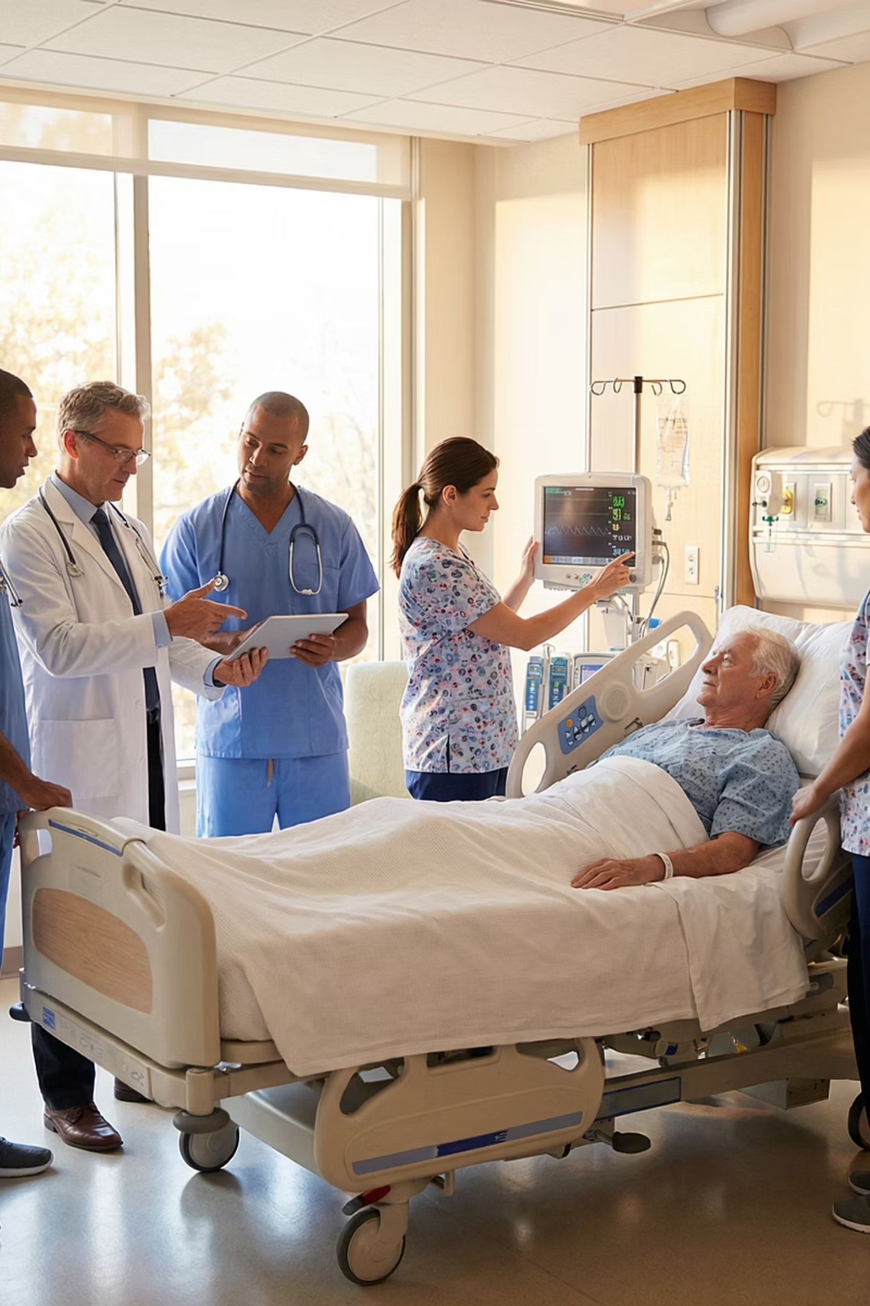
Your Wound Care Team: Clinical Excellence
Methodist Le Bonheur's wound care team stands as a beacon of expertise and compassion.
Board-Certified Specialists: Our team is led by board-certified wound care physicians and specialists, ensuring the highest standards of care.
Multidisciplinary Approach: A collaborative model integrates physicians, specialized nurses, and hyperbaric oxygen therapists for holistic patient management.
Advanced Certifications: Ongoing training and advanced certifications keep our team at the forefront of innovative wound care techniques.
Decades of Experience: With years of combined experience, our specialists possess deep knowledge in treating even the most complex chronic wounds.
Patient-Centered Philosophy: Every treatment plan is tailored to the individual, prioritizing patient well-being, comfort, and successful limb salvage outcomes.

Slide 14

Meet Your Wound Care Leadership
Our dedicated team at Methodist Le Bonheur brings together diverse expertise, united by a shared commitment to advanced wound care and limb preservation. Meet the leaders driving our clinical excellence:
Dr. Emily Chen
Sarah Davies, RN, CWCN
Dr. Mark Johnson
Maria Rodriguez
Medical Director, Wound Care & Limb Preservation
Lead Wound Care Coordinator
Director, Hyperbaric Medicine
Patient Navigator, Wound Care
A Certified Wound Care Nurse, Sarah is vital in patient education, treatment plan coordination, and ensuring seamless therapy integration. She champions patient-centered care and optimal healing pathways.
Dr. Johnson is a recognized expert in hyperbaric oxygen therapy. He ensures cutting-edge HBOT delivery and research, significantly enhancing outcomes for complex wounds and complementing our limb salvage efforts.
Maria is dedicated to guiding patients and their families through every step of their treatment journey, from initial assessment to post-healing support, ensuring holistic and compassionate care experiences.
Board-certified Vascular Surgeon, Dr. Chen leads our multidisciplinary team. With 15+ years of experience, she spearheads innovative protocols, integrating advanced therapies for superior patient outcomes.

Slide 15


Methodist Le Bonheur: A Regional Leader
Key Facilities Across Memphis Metro
University Hospital
North Hospital
Germantown Hospital
South Hospital
Flagship medical center
Serving northern communities
Community care hub
Dedicated to southern regions
Driving Regional Influence
Academic Affiliation
Regional Referral Center
Partnership with UTHSC for evidence-based innovation.
A trusted hub for specialized patient care.
Community Healthcare
Innovation & Quality
Leadership in local health initiatives.
Commitment to advanced care and excellence.
Central to Regional Healthcare
When Methodist adopts innovation, the region follows.

Slide 16

Perfect Synergy: ActiGraft + Your Hyperbaric Oxygen Program
This will highlight how ActiGraft complements Methodist Le Bonheur's existing limb preservation and HBOT capabilities.
HBOT
Superior Outcomes
ActiGraft
Both HBOT and ActiGraft offer distinct advantages that, when combined, create a powerful synergistic effect for advanced wound healing and limb preservation.
Your Limb Preservation Excellence
Key Contributions to Healing
Methodist Le Bonheur is recognized for comprehensive limb salvage programs including:
HBOT Benefits:
Hyperbaric oxygen therapy (HBOT)
Advanced wound care protocols
Multidisciplinary approach
Vascular intervention capabilities
Increases tissue oxygenation
Enhances angiogenesis
Reduces inflammation
Prepares wound bed
ActiGraft Benefits:
Delivers growth factors & stem cells
Creates biological scaffold
Promotes tissue regeneration
Autologous (patient's own blood)
Complementary Mechanisms
Simultaneous Use
Superior Outcomes
HBOT and ActiGraft work through different but reinforcing biological pathways.
These therapies can be integrated into a unified treatment protocol for complex cases.
The combined approach leads to enhanced healing, reduced amputations, and improved patient recovery.
ActiGraft is fully compatible with HBOT protocols. Many centers use them together for complex limb salvage cases.
What if you could enhance your already-excellent HBOT outcomes with advanced biologics?

Slide 17
GPO & Procurement: Your Questions Answered
1
2
3
Do we need to negotiate a contract?
How long does formulary approval take?
What documentation does P&T need?
No. You're covered through Premier (since March 2022).
Typically 30-60 days through your P&T committee.
Clinical evidence package
GPO confirmation
Reimbursement summary
4
5
Are there hidden costs?
What about reimbursement risk?
No. Transparent pricing through Premier.
No equipment, no cold chain infrastructure.
Minimal.
NCD 270.3 provides stable Medicare coverage.

Slide 18
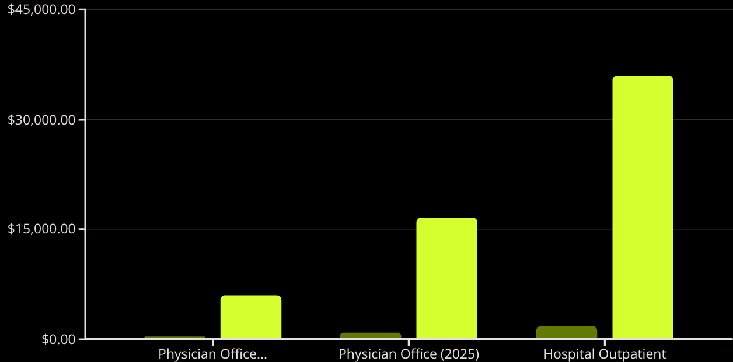

Reimbursement: Stable and Improving
CMS made ActiGraft more accessible in 2025:
Reimbursement Comparison (Per Treatment vs. 20-Week Max)
Hospital Outpatient:
$1,800 per treatment
Up to 20 treatments covered
Total potential: $36,000 per patient
Physician Office (NEW in 2025):
$830 per treatment (up from $300)
Opens new deployment channels
Total potential: $16,600 per patient
Bottom line:
NCD 270.3 ensures stable Medicare coverage with minimal denial risk.
Per Treatment
20-Week Maximum
Assessment
Advanced Therapy
Angiogram, revascularization, infection control
HBOT, weekly ActiGraft PRO, NPWT
Ongoing Care
Wound Prep
Debridement, offloading, moisture balance
Weekly review, reapply ActiGraft, patient education

Slide 19
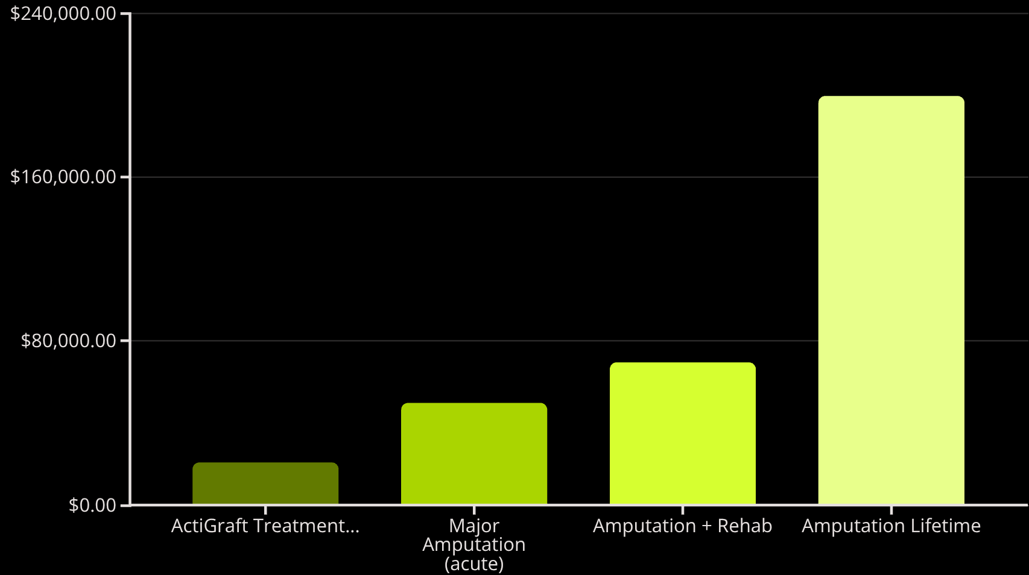
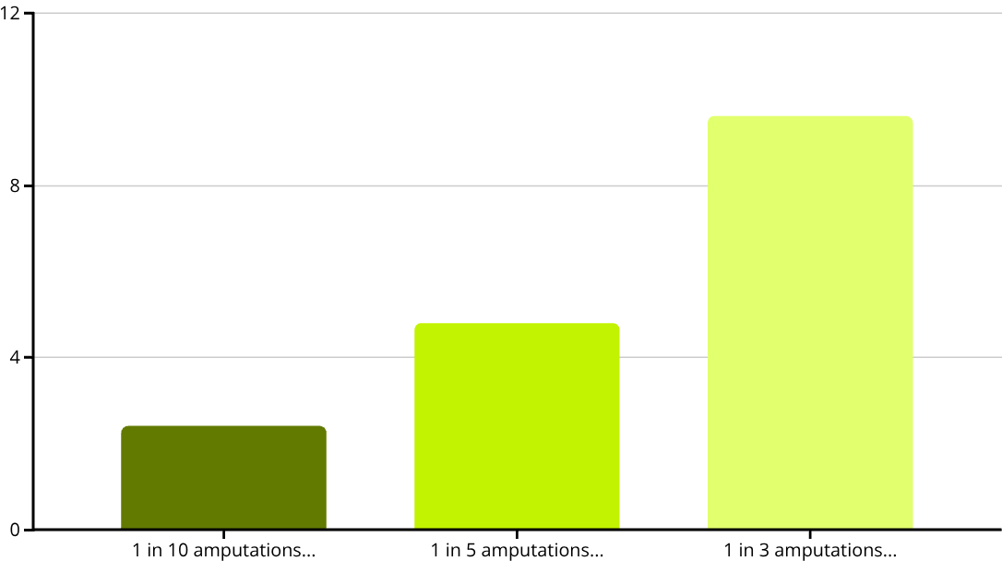
The Economic Case: Prevention vs. Amputation
Total Cost Comparison
Return on Investment (ROI) with Amputation Prevention
The Math:
ActiGraft treatment (12 weeks): $20,700
Major amputation (lifetime): $200,000+
If 1 in 10 amputations prevented: 2.4× ROI
If 1 in 5 amputations prevented: 4.8× ROI
The Question:
How many amputations could your program prevent this year?

Slide 20
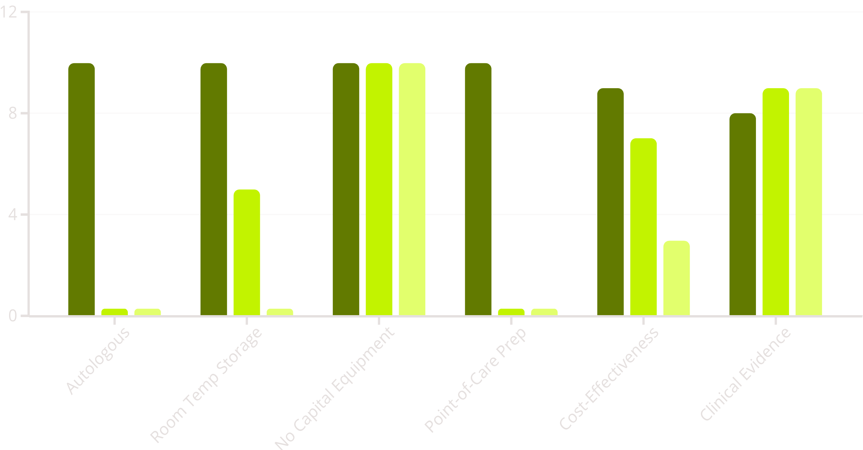

Head-to-Head Positioning: ActiGraft PRO vs. Key Competitors
How does ActiGraft compare across key attributes?
ActiGraft PRO
Integra/PriMatrix
Apligraf
Which of these attributes matter most to your program?

Slide 21

How ActiGraft Fits Your Toolkit
You likely use Integra, Organogenesis, or MiMedx products. ActiGraft complements them:
Integra/PriMatrix
ActiGraft
Acellular dermal matrix
Allogeneic (donor tissue)
Established protocols
Whole blood clot
Autologous (patient's own)
Different mechanism
When to Consider ActiGraft
Patients with cultural/religious concerns about donor tissue
Immunocompromised patients
Patients on anticoagulants
When current products haven't achieved closure

Slide 22
ActiGraft vs. Organogenesis Products
Organogenesis (Apligraf, Dermagraft)
ActiGraft
Allogeneic (donor tissue)
Requires cold chain (2-8°C)
Risk of temperature excursions
Cultural/religious considerations
Autologous (patient's own blood)
Room temperature storage
No cold chain complexity
No donor tissue concerns
Simpler operations. Fewer concerns. Better for multi-site systems.

Slide 23
ActiGraft vs. Amniotic Membrane Products
MiMedx (EpiFix, AmnioFix)
ActiGraft
Amniotic membrane (donor tissue)
Room temperature storage
Batch-to-batch variability
Whole blood clot (patient's own)
Room temperature storage
No donor variability
FDA 510(k) cleared
Both store at room temp. ActiGraft eliminates donor tissue concerns.

Slide 24
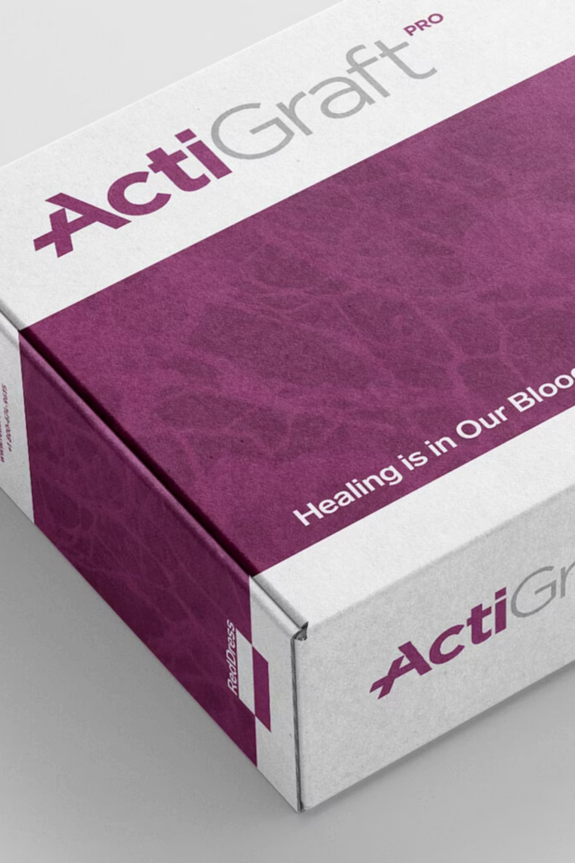
The "No Cold Chain" Advantage
Refrigerated biologics create hidden operational burdens:
Cold Chain Challenges
ActiGraft Simplicity
Specialized refrigeration ($3K-$15K)
24/7 temperature monitoring
Staff training requirements
Product waste from excursions
Limited shelf life
Weekend/holiday monitoring
✓ Room temperature storage (5-30°C)
✓ No refrigeration needed
✓ No monitoring systems
✓ Zero temperature-related waste
✓ Longer shelf life
✓ Perfect for multi-site systems
Annual savings: $15K-$50K for a 3-5 center system

Slide 25
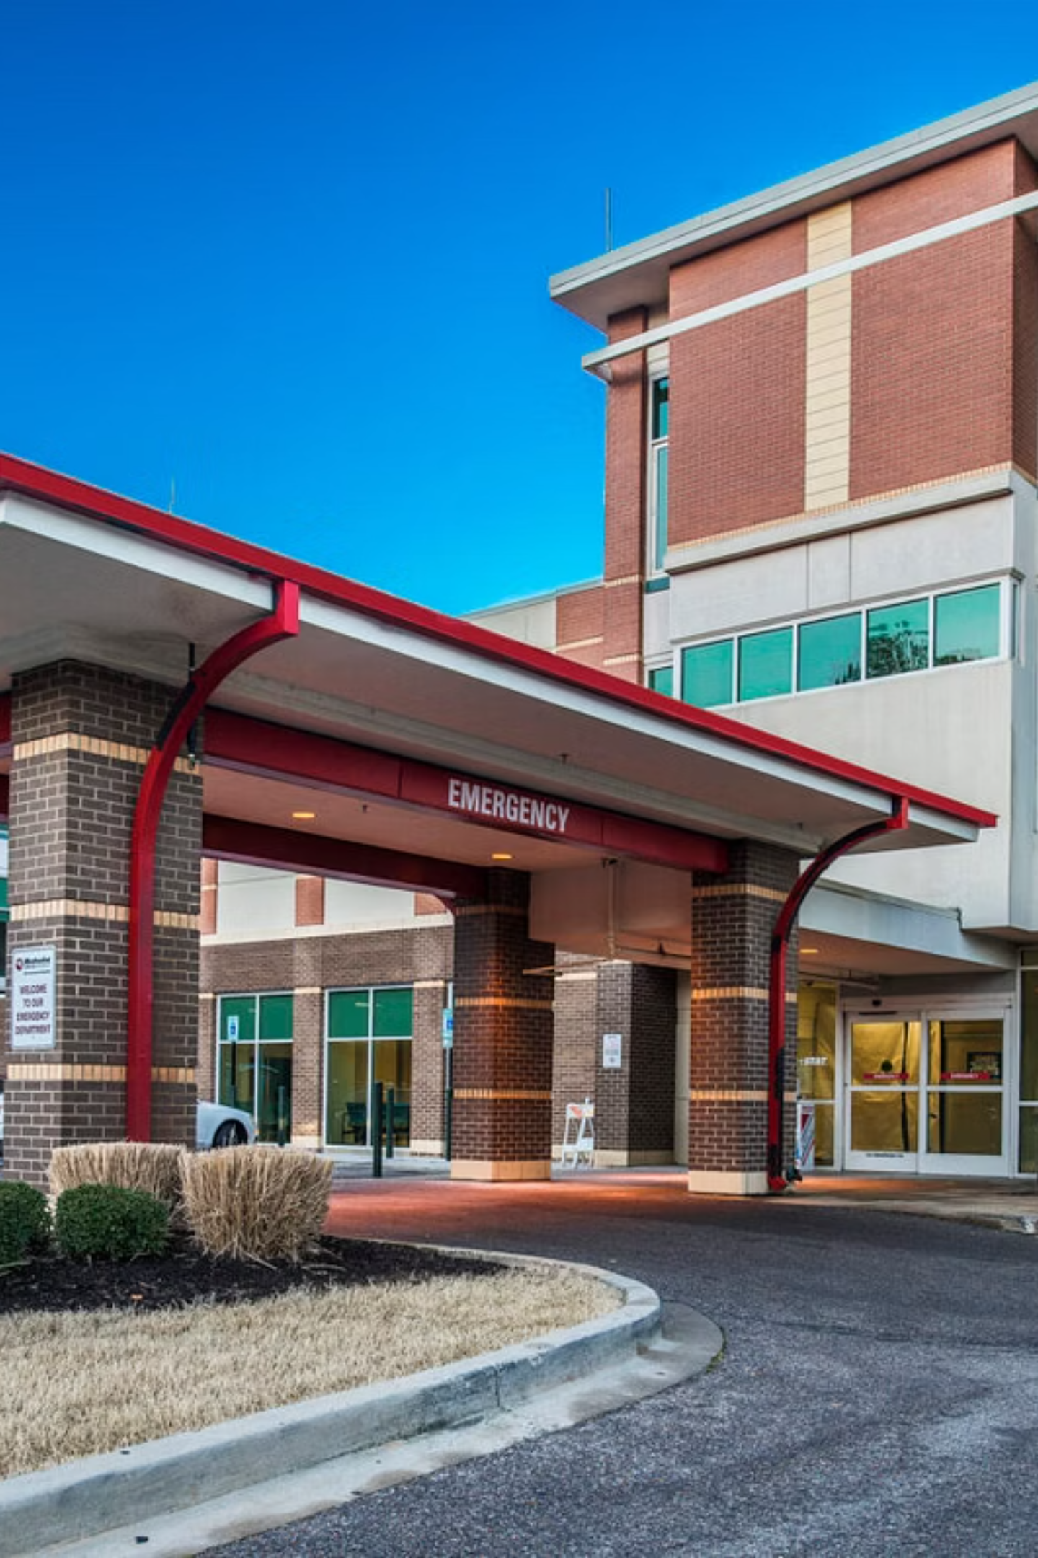
Next Steps: Let's Work Together
Immediate Next Steps
01
Clinical team meeting (patient selection)
02
P&T coordination (GPO contract review)
03
Product demo & training session
04
Identify 10-15 patients for 90-day trial
What We'll Provide
Clinical evidence package & product monograph
Premier GPO confirmation docs
Reimbursement & billing support
On-site training for staff
Outcomes tracking tools
Our Commitment
True partnership. Not product pushing. Tools that improve outcomes and simplify operations.
Contact Information
[Your name and contact details]
Ready to discuss? Let's talk about your specific needs.

Slide 26

Why Partner with Nightingale?
We're Different:
What We Provide:
Clinical consultants, not sales reps
Deep wound care expertise
Long-term partnership focus
Comprehensive training & implementation support
Outcomes tracking & data analysis
Responsive local support team
Regular business reviews
Our Commitment to Sandy's Team:
Dedicated account support
On-site clinical specialist for first cases
Ongoing staff education
Early forecasting & planning
Your success is our success. Let's build this together.

